Slide 1
The ovary
The ovary develops from 3 sources : coelomic epithelium, primordial germ cell and intermediate mesoderm :
Coelomic epithelium: which gives rise to the follicular cells
Primordial germ cells: Enodermal cells and they arise from the caudal wall of yolk sac close to allantois , these sells migrate from mesentery of hind gut to the genital ridge ➔ they give rise to the oogonia
Intermediate mesoderm: forms connective tissue stroma of the ovary

Slide 2
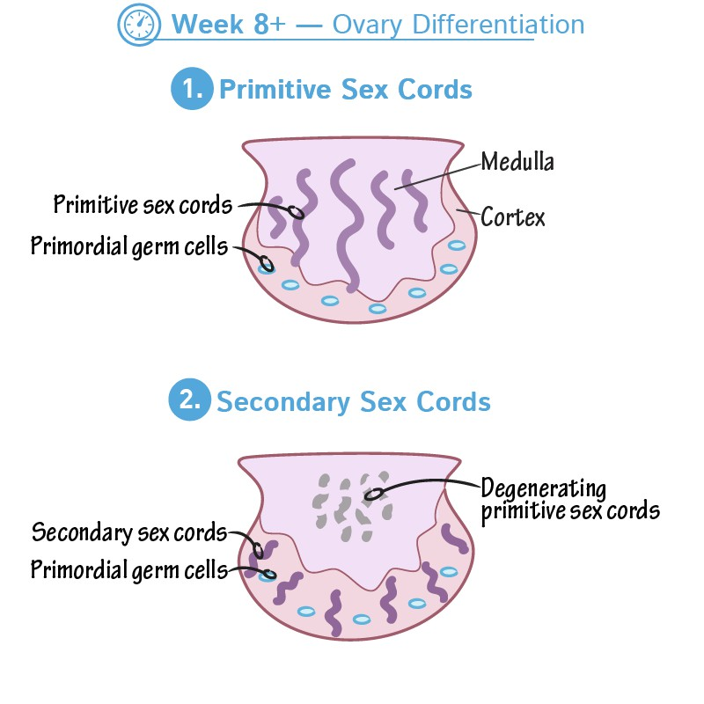
The ovary
Indifferent stage: as early as 6th week of intrauterine life ➔ the ovary shows primitive sex cords ( from coelomic epithelium)
These primitive cords in medulla of ovary Primitive sex cords are replaced by definitive
sex cords which appear in cortex of the ovary
Definitive sex cords at the cortex break into clusters that surround the primordial germ cell to form the primordial follicle.

Slide 3
The ovary
The ovary reaches the false pelvis in 3rd month and true pelvis shortly after birth
Ovary is attached to the gubernaculum which is a fibromuscular cord of mesodermal origin , this cord traverse the anterior abdominal wall in inguinal canal to be attached to labium majus
The gubernaculum is fused with the side of the uterus at the point of meeting between uterine tube and the uterus so the gubernaculum is divided into 2 parts
Cranial part➔ between uterus and ovary forms➔ ligament of the ovary
Caudal part➔ between uterus and labium majus ➔ round ligament of uterus
As it descends,the ovary pulls its vessels , lymphatics and autonomic nervous system

Slide 4
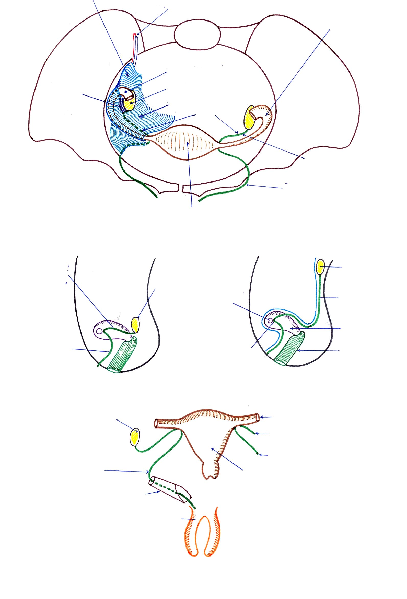
Ovary
Lig. of ovary
Ovary
Gubernaculums ovarii
Opening of Fallopian tube
Uterus
Round lig. Of uterus
Cornu
Vagina
Ovary
Fallopian tube
Lig. Of ovary
Round lig. Of uterus
Round lig. Of uterus
Uterus
Inguinal canal
Labium majus
Ligaments of uterus

Slide 5
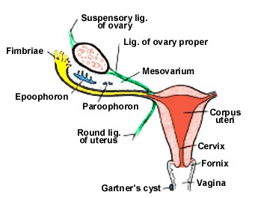

Slide 6
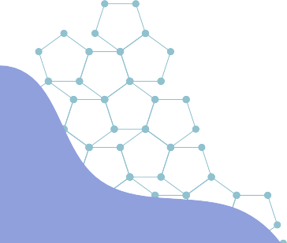
The female reproductive system

Slide 7
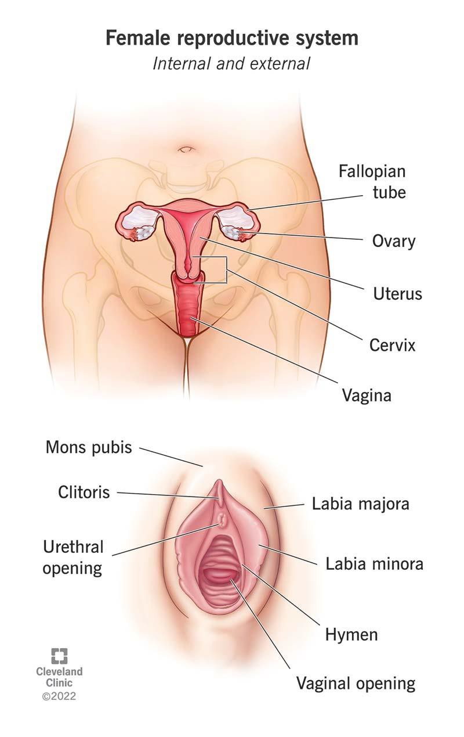
The female reproductive system
The system is formed of internal part and external part.
The internal genitalia consists of:
Gonad (ovary)
Duct system (uterine tube, uterus and vagina).
  The external genital part consists of:
Labia majora
Labia minora 3.Clitoris 4.Vestibule.

Slide 8
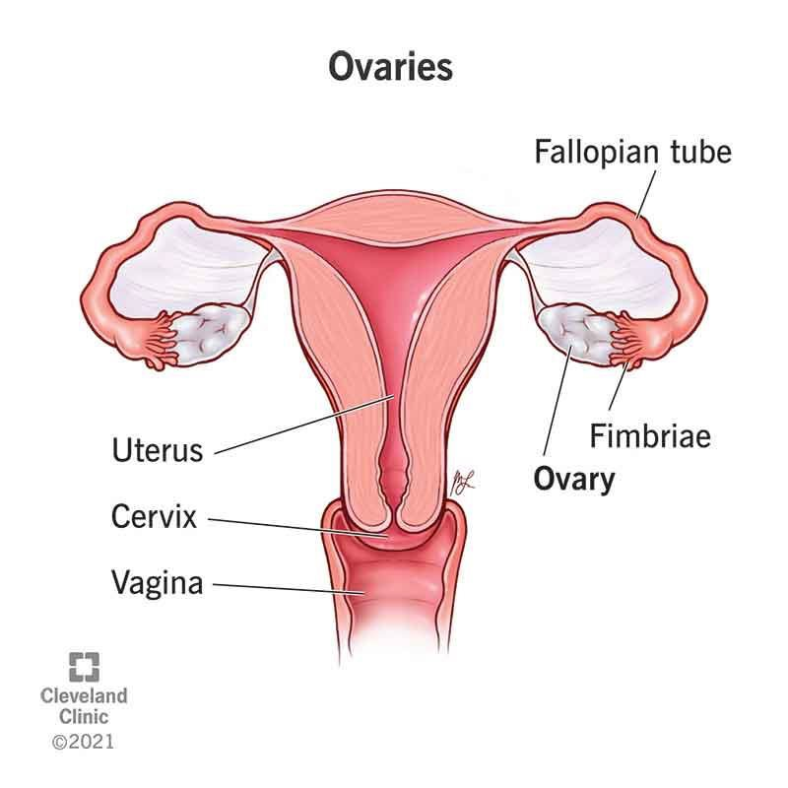
The ovary
Description:
Almond shaped, paired intraperitoneal organ on right and left side of the uterus
About 4x2x1cm.
The fibrous capsule of the ovary is called tunica
albuginea.
The capsule is covered by a layer of modified peritoneum termed germinal epithelium.

Slide 9
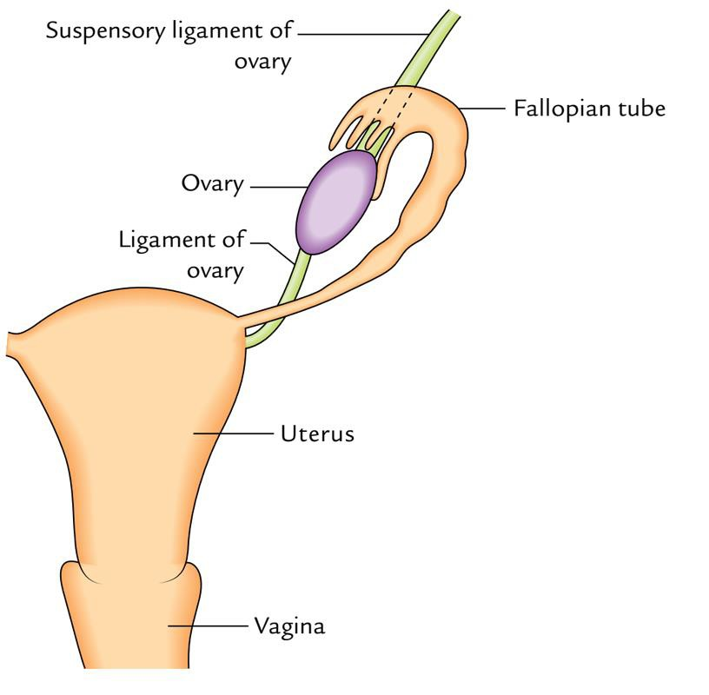
The ovary
External Features
The ovary in a nulliparous woman has;
Two ends: superior (tubal) and inferior
(uterine)
Two borders: anterior (attached or mesovarian) and posterior (free).
Two surfaces: lateral and medial.

Slide 10
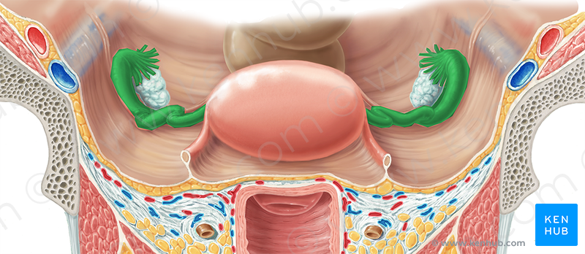

Slide 11
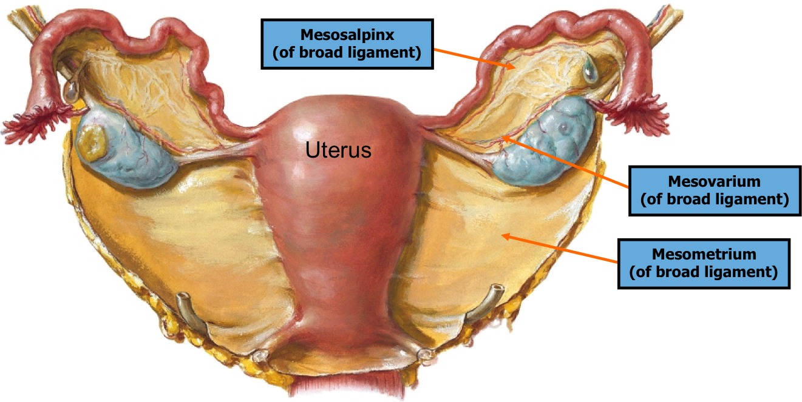

Slide 12
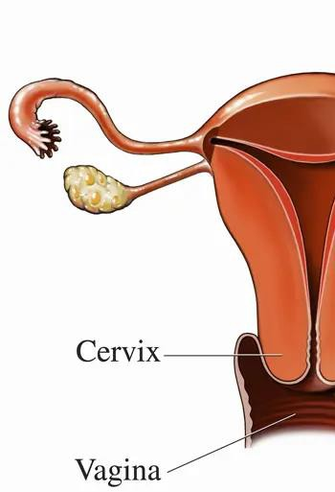
The ovary
1) Two ends:
-Tubal end: is related to uterine tube and attached to the ovarian fimbria of
uterine tube and to side wall of pelvis by the suspensory ligament of the ovary.
-Uterine end: is connected by the ligament of the ovary to the supero- lateral angle of the uterus,

Slide 13
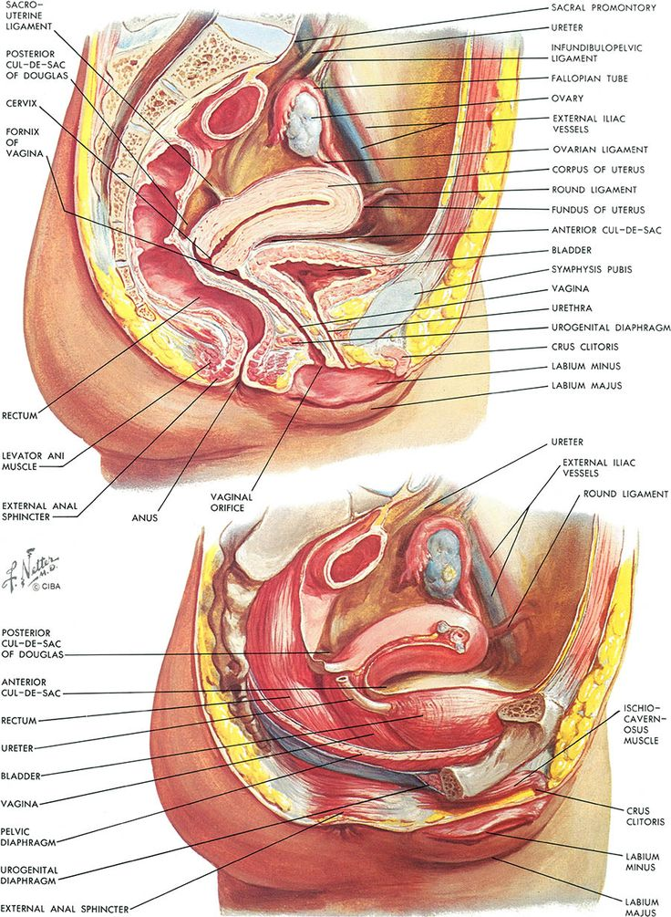

Slide 14
The ovary
2) Two borders:
Anterior (attached or mesovarian) border: forms the hilum of the ovary and is attached to the upper layer of broad ligament by a short peritoneal fold called mesovarium.
Posterior (free) border: is convex and related to the uterine tube.

Slide 15
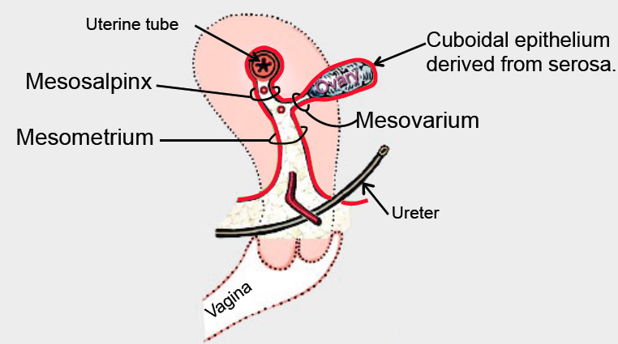

Slide 16
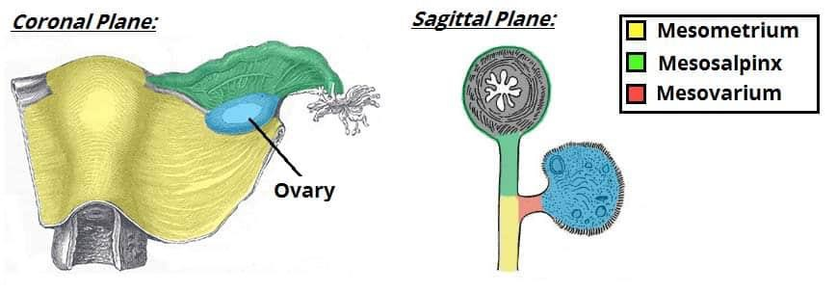

Slide 17
The ovary
Note: The part of the broad ligament that extends from the tubal end of the ovary and the end of the tube to the side wall of the pelvis is called "suspensory ligament of the ovary" through which pass the ovarian blood vessels, lymphatics and nerves.

Slide 18
Suspensory ligament of ovary (or infundibulo- pelvi lig.)
Ovarian vessels
Fallopian tube
Infundibulum
Mesovarium
Ovary
Broad lig.
lig. Of ovary
Ligament of ovary
Round ligament of Uterus
Uterus
Ligaments of the Uterus

Slide 19
The ovary
3) Two surfaces:
a) Lateral surface: is related to the parietal peritoneum of a depression in the lateral wall of the pelvis calle the ovarian fossa.
The ovary is closely related to the obturator nerve & vessels in the ovarian fossa → disease of the ovary may cause referred pain to the medial aspect of the thigh and knee
The fossa is bounded by the obliterated umbilical artery anterior and internal iliac vessels and ureter posterior.
b)The medial surface of the ovary is related to the infundibulum of the uterine tube.

Slide 20
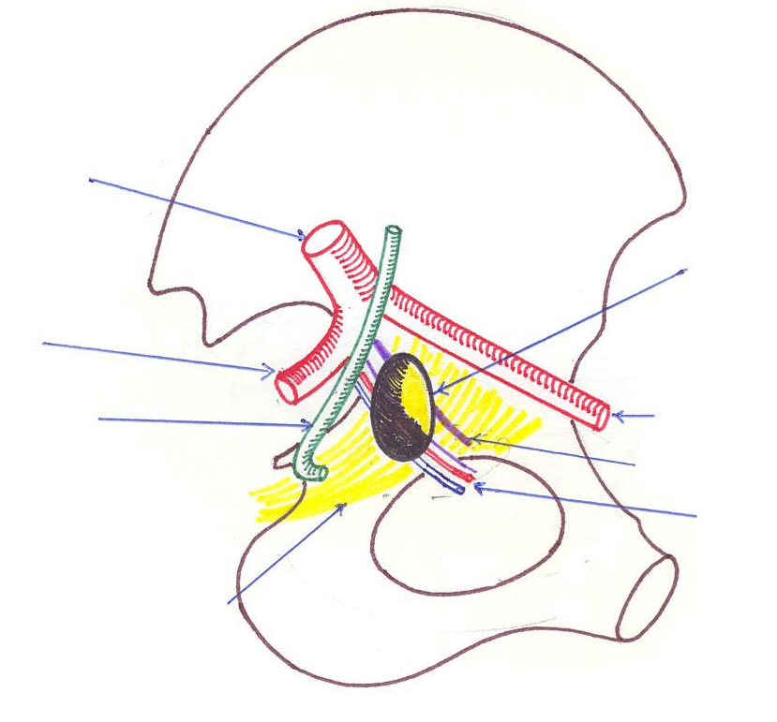

Slide 21
The ovary
The ovary is usually found hanging in the rectouterine pouch (Douglas pouch). It is attached to the back of the broad ligament by the mesovarium.
It has the following ligaments :
1) Suspensory ligament of the ovary: which is a part of the broad ligament that extends from the mesovarium to the lateral wall of the pelvis.-The ligament transmits ovarian vessels and nerves.
2) The ligament of the ovary: extends from the ovary to the supero-lateral angle of the uterus

Slide 22
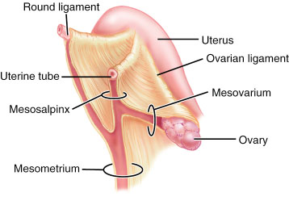

Slide 23
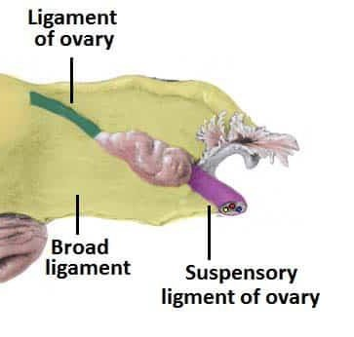
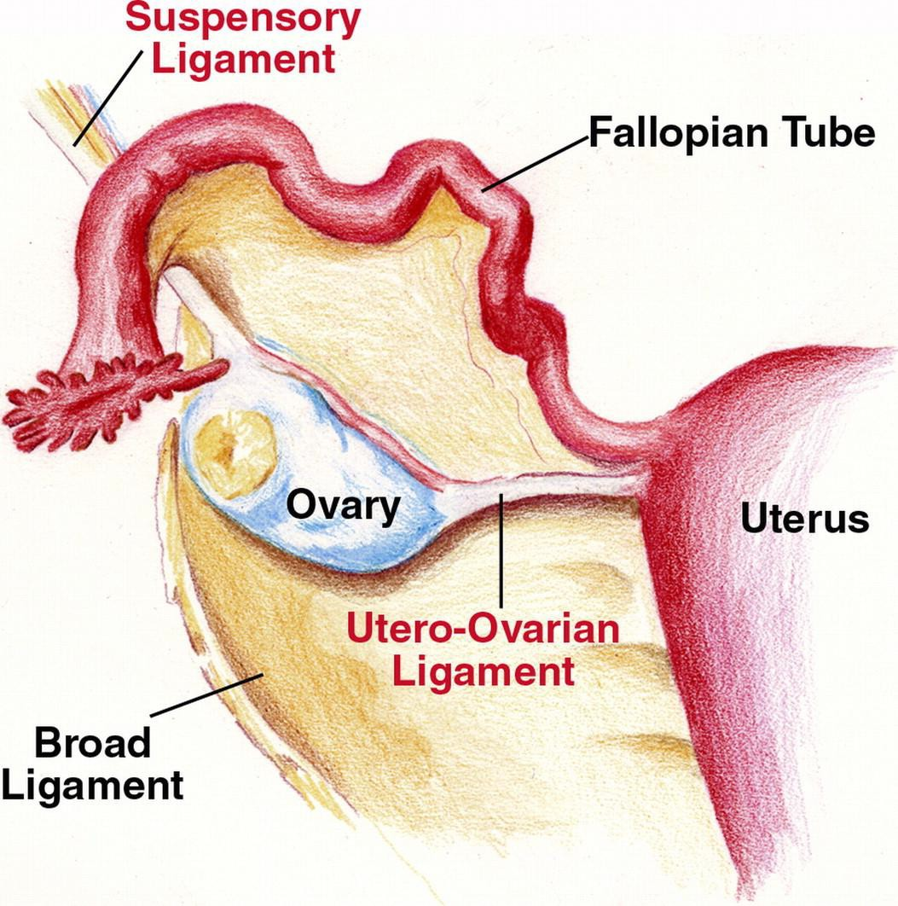

Slide 24
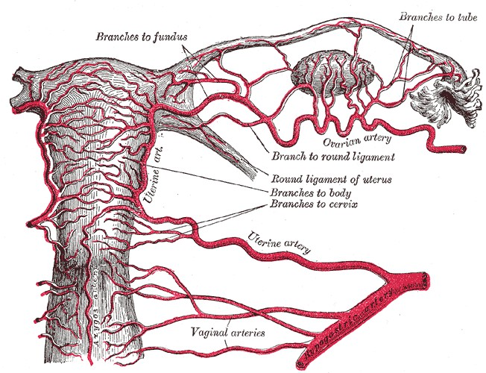
The ovary
Arterial blood supply:
Ovarian artery: from abdominal aorta.
The artery passes through the suspensory ligament of ovary, then through the mesovarium to enter hilum of ovary.
Uterine artery : through its ovarian branch
which anastomoses with branches of ovarian artery.

Slide 25
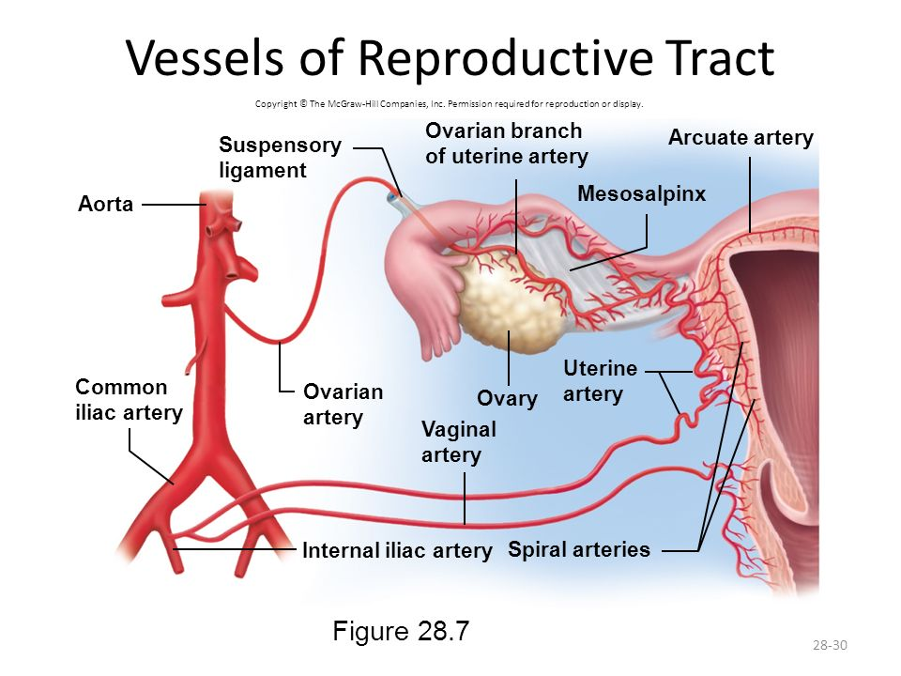

Slide 26
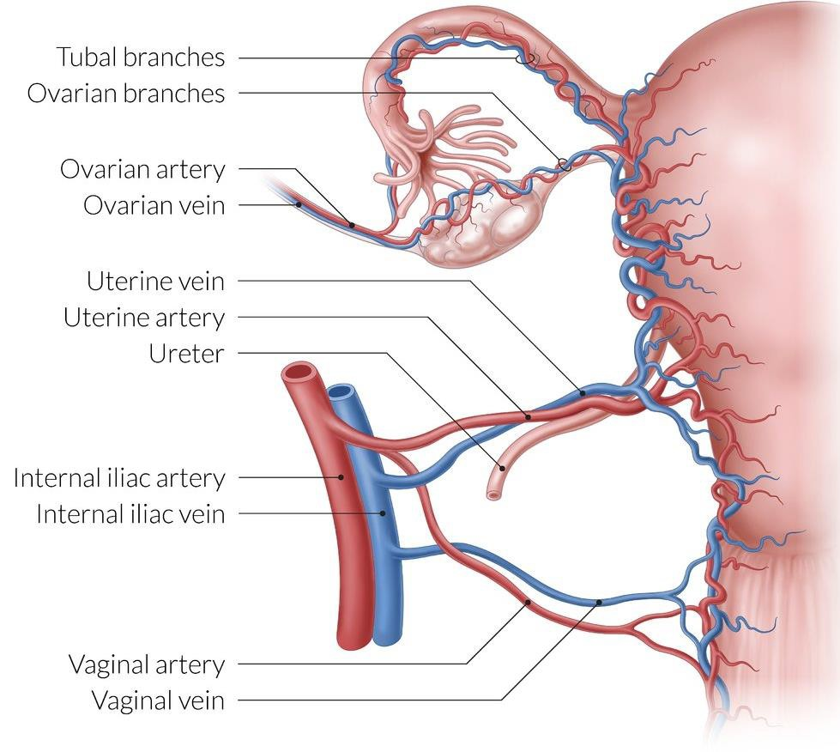
The ovary
Venous drainage:
Veins emerge from the hilum to form a pampiniform plexus of veins which unite to give ovarian vein.
The right ovarian vein ➔ ends in the I.V.C.
The left ovarian vein➔ ends in the left renal vein

Slide 27
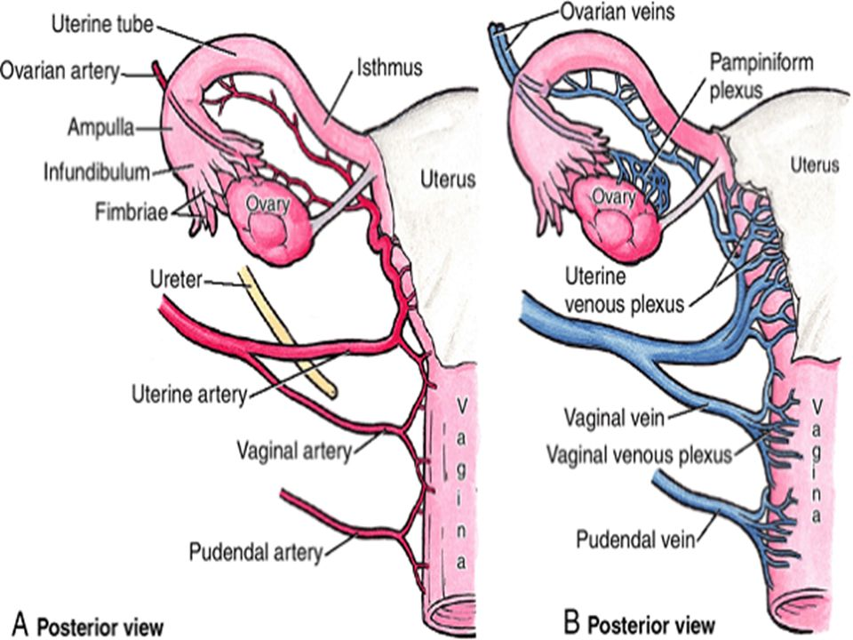

Slide 28
The ovary
Lymphatic drainage: into the lateral and pre-aortic lymph nodes.
Nerve supply: by autonomic plexus around the ovarian artery.

Slide 29
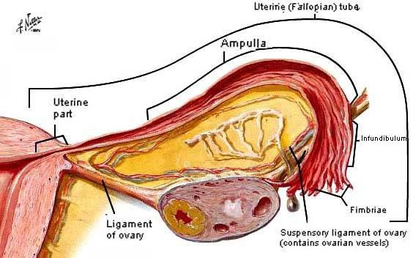
The uterine tube
The two uterine tubes are on either side of the uterus.
Each tube is 10 cm long.
It opens medially into the uterine cavity.
It opens laterally into the peritoneal cavity in the region of the ovary.

Slide 30
The uterine tube
The uterine tube is divided into 4 parts arranged from the surface of the ovary to the uterus:
1.The infundibulum: (2cm long) It is the funnel lateral part of the uterine
tube. Its edge has fimbriae which are hanging over the ovary and one of these fimbriae is long and termed ovarian fimbria.
In the bottom of the infundibulum is the opening of the tube into the peritoneal cavity ( abdominal ostium).

Slide 31
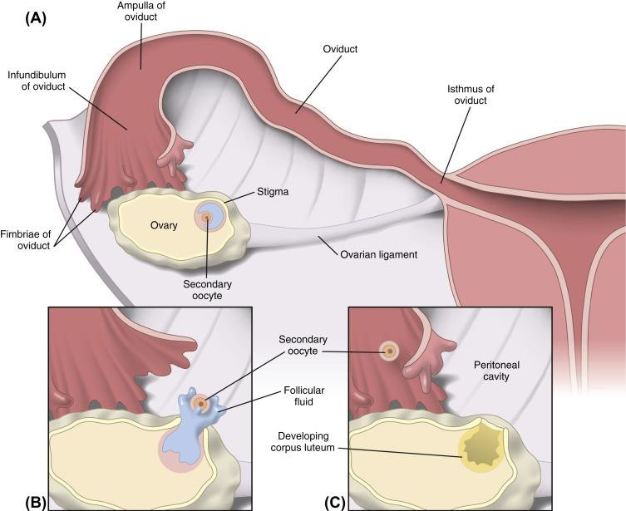

Slide 32
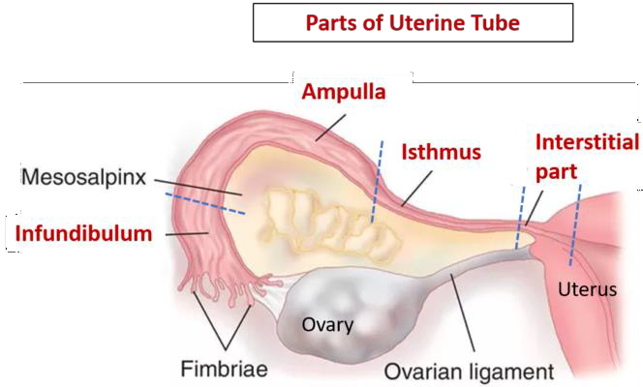
The uterine tube
The ampulla (5cm): It is the longest and widest part of the tube and it is the site of fertilization.
The isthmus (2cm long): is the part lateral to the uterus , it forms the medial 1/5 of the uterine tube.

Slide 33
The uterine tube
4. The intramural (interstitial) part ( 1cm):
It is the part piercing the uterine wall.
It is the narrowest and shortest.

Slide 34
The uterine tube
The part of the broad ligament between the mesovarium, ligament of the ovary and the tube is known as mesosalpinx.

Slide 35
The uterine tube
Arterial supply:Medial 2/3➔ uterine artery and Lateral 1/3 ➔ ovarian artery
Venous drainage:The veins correspond to the arteries
Nerve supply:Medial 2/3 by uterine nerve plexus & Lateral 1/3 by ovarian nerve plexus

Slide 36
The uterine tube
Lymph drainage
Most of tubal lymphatics to lateral aortic and pre-aortic lymph nodes.
Lymphatics from isthmus and utero-tubal junction accompany the round
ligament of the uterus to the superficial inguinal lymph nodes.

Slide 37
The uterine tube
Clinical notes:
The abdominal ostium of the tube is a potential pathway of ascending infection
from female genital system to the peritoneal cavity that may cause peritonitis.
Inflammation of the uterine tube is called salpingitis
collection of pus in the tube is called pyosalpinx.
Salpingitis and pyosalpinx could lead to tubal adhesion and blockage which 'is the main cause of sterility in women.

